Slide 1
Predicting Water Well Failures Using Machine Learning
Analysis by Brian Bentson
Notes:
Ministry of water and irrigation

Slide 2
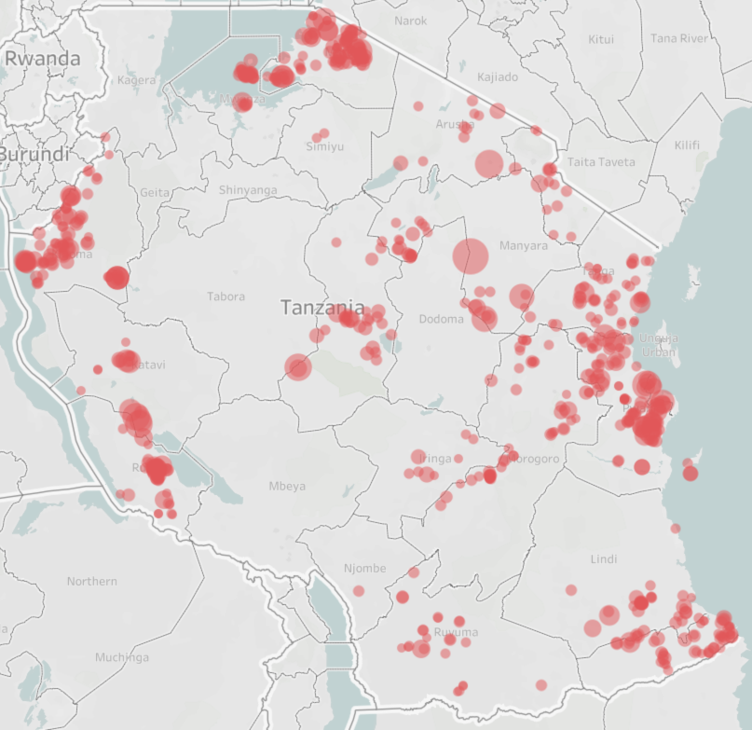
Predicting Well Failure Can Save Lives
Non-Functional wells that support over 1,000 citizens
Sized by population
Tanzania has almost 60,000 water wells in dataset with 45% not functional, leaving almost 7M people without a reliable water source
Humans can only live up to 3 days without water
Ability to predict water well failures and respond quickly can be the difference between life and death
Tanzania
Notes:
Ministry of water and irrigation

Slide 3
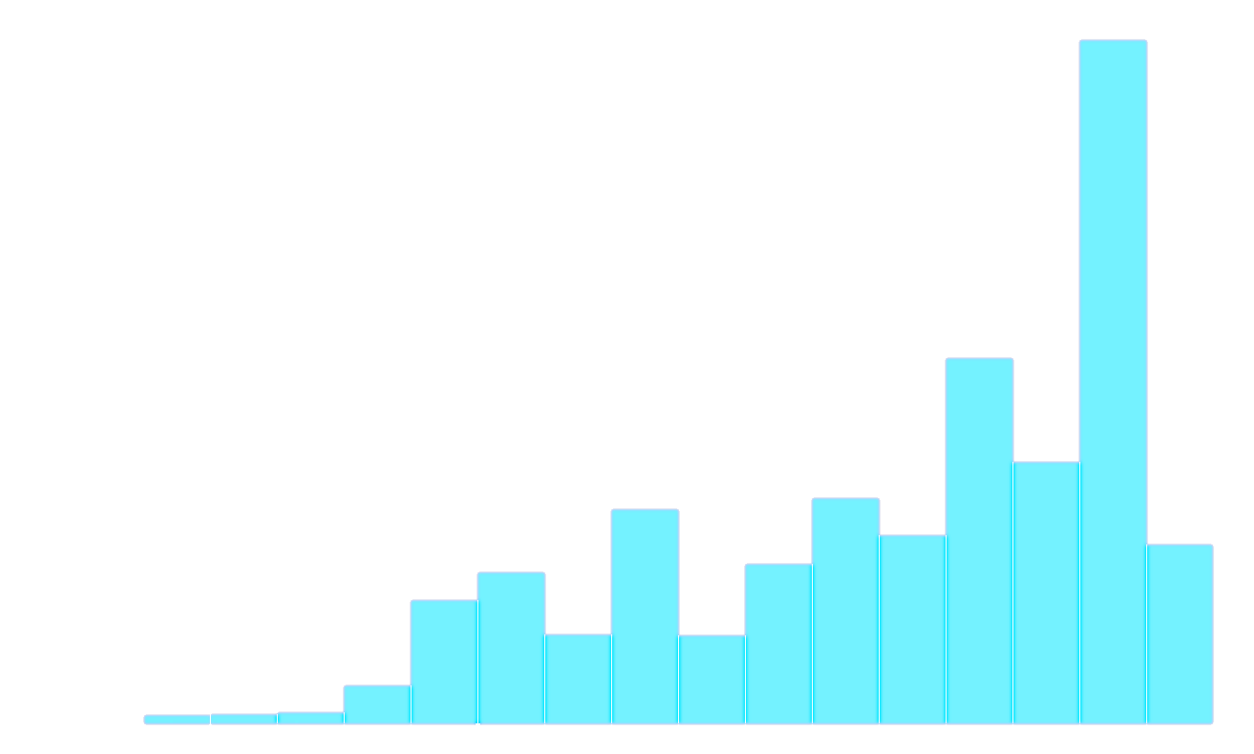
Analysis Overview
Consolidation of Well Status
31,385
26,194
4k
Equated wells functioning at a reduced capacity as not functioning
Almost 18,000 water wells with zeros for population, head, well elevation and construction year
Created well_age feature
Functional
Functional
Non Functional
Functional Needs Repair
Non Functional
Distribution of Well Construction Year
19k
Random Imputation
12.5k
Well Count
5k
0
1955
2000
2015

Slide 4
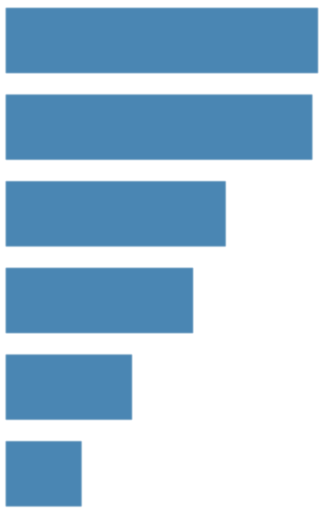
Best Classification Modeling of Well Status
Random Forrest
Prioritized finding all well failures, therefore accepting some false positives
Focused on models with high interpretability to understand what drives well failures
Best model was a Random Forrest that could detect failures 77% of the time
Location, well age and head are important for the model
Random Forest Feature Importances
Sorted by Most Important
Longitude
Latitude
Well Elevation
Population
Well Age
Head
Notes:
Define recall or define accuracy or showcase accuracy or show the matrix

Slide 5
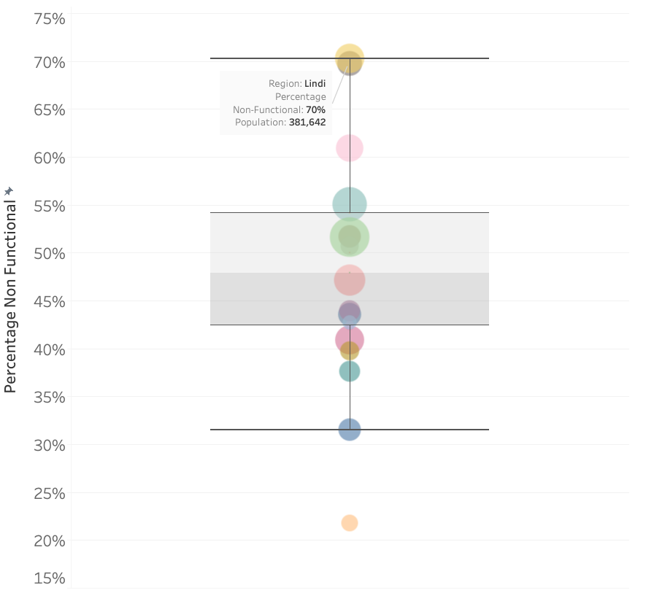
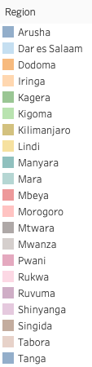
Location Affects Reliability
Distribution Percentage Non-Functional by Region
Sized by population
High variability in well function across regions
Many Regions with high failure percentage and high population
Recommendation: Focus on regions which have historically high failure percentage

Slide 6
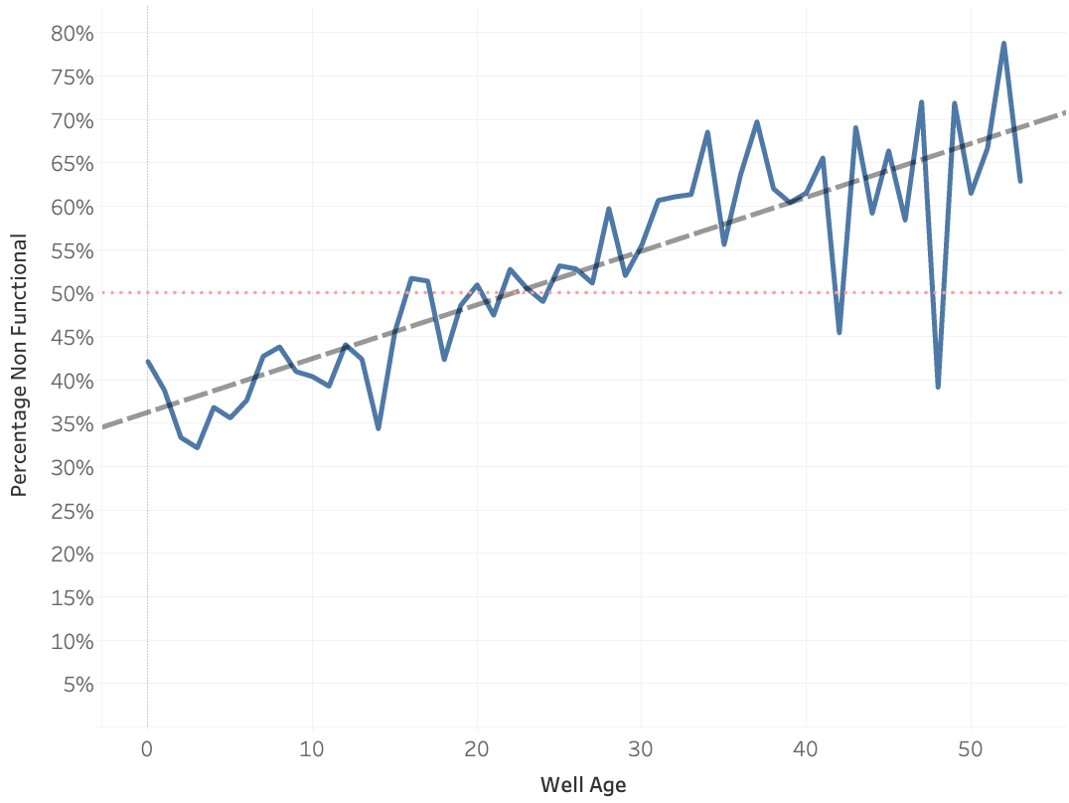
Well Age Negatively Affects Reliability
Percentage Non-Functional by Age
As well ages increase, the percentage of non-functional wells increases
If a well is over age 24-25, it is more likely that well will be non-functional rather than functional
2.5M people are supported by older wells (>24 years old)
Recommendation: Focus maintenance on older wells to maintain supply of water

Slide 7
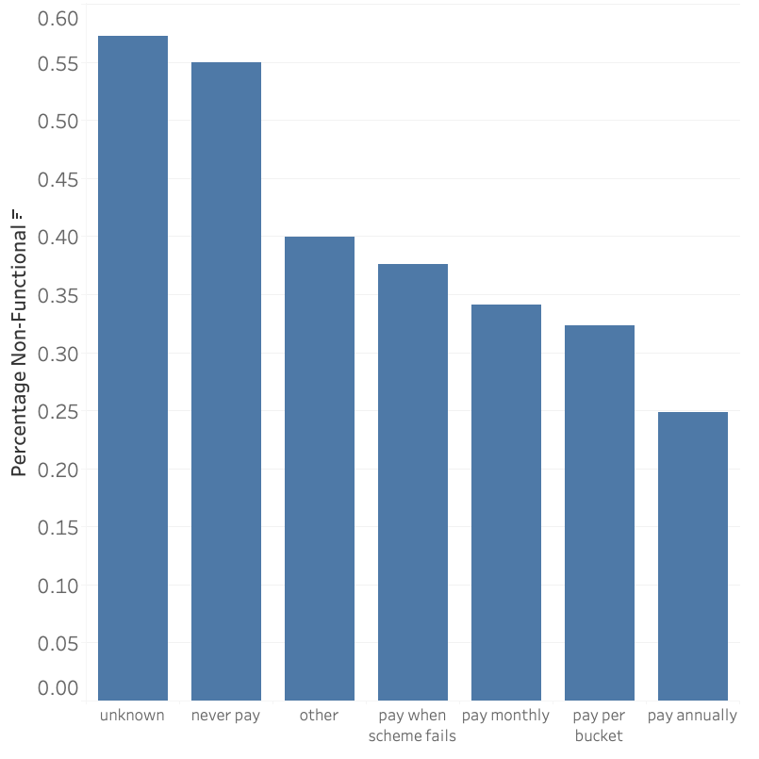
You Get What You Pay For
Distribution of Non-Functional Percentage by Water Cost
While not specifically important for the random forest model, there is a clear trend between showing that if you pay for the water, the wells reliability is higher
Recommendation: Focus on supporting the populations which cannot afford to pay for water

Slide 8
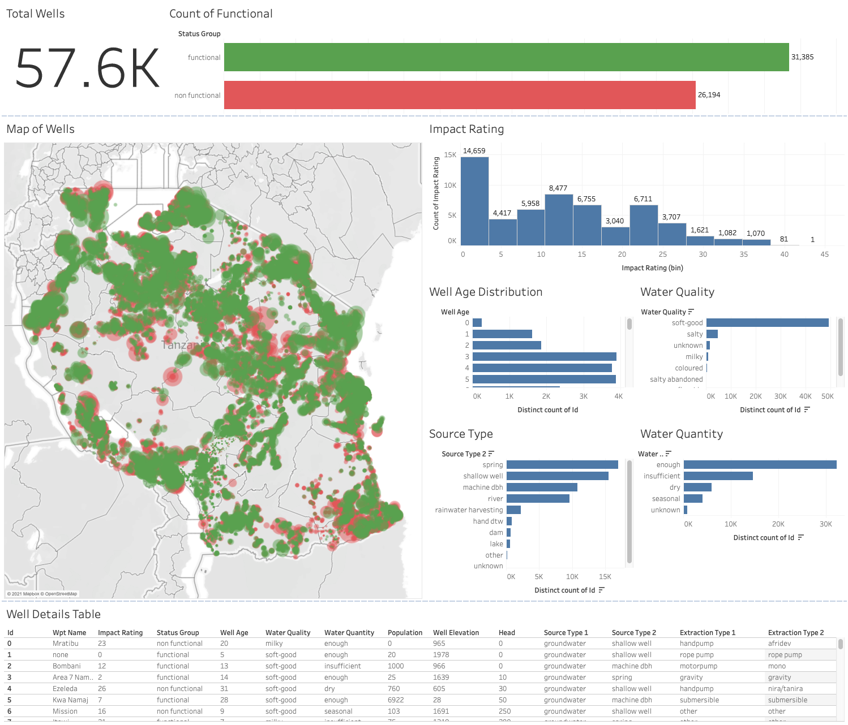
Recommendations & Next Steps
Recommendations
Keep an eye on older wells as the likelihood of failure increases with age
Develop support model for population areas that do not pay for water since analysis shows paying for water brings better reliability
Utilize business insights tools to keep stakeholders up to date with key performance metrics
Improve data governance to ensure better data quality and better predictions
Next Steps
Use more sophisticated algorithms that may perform better at finding well failures but does not tell you why they are failing
Screenshot of BI Dashboard

Slide 9
Thank you
Questions?

Slide 10
BACKUP

Slide 11
Lower Static Head Indicates Failure
31 FH
23 FH
As well ages increase, the amount of static head on the well will decrease, lowering water quantity
This can be artificially improved by technology such as a pump
Recommendation: Keep a close eye on static head as it directly correlates with water quantity
Amount of Static Head by Well Status
Functional
Non Functional
Amount of Static Head by Water Quantity
Enough
30 FH
Insufficient
28 FH
Seasonal
22 FH
Dry
18 FH
Unknown
16 FH

Slide 12
Most Important Features from Model
Random Forest Feature Importances
Sorted by Most Important
Longitude
Location (longitude and latitude) is the most important feature for predicting well function
Well age directly affects reliability
Well Elevation and Population are important features for prediction, although analysis did not highlight specific relationships
Latitude
Well Elevation
Population
Well Age
Head

Slide 13
Lower Static Head Indicates Failure
31 FH
As well ages increase, the amount of static head on the well will decrease, lowering water quantity
This can be artificially improved by technology such as a pump
Recommendation: Keep a close eye on static head as it directly correlates with well function
23 FH
Amount of Static Head by Well Status
Functional
Non Functional

Slide 14
Data Quality a Potential Issue
18K
Almost 18,000 water wells with zeros for population, head, well elevation and construction year
Outliers and improbable values in the head that can skew results
Zeros in construction year were converted to years based on distribution of non-zero values
Notes:
Combine with next slide

Slide 15
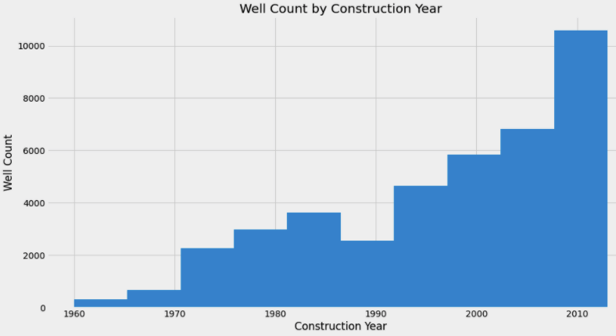
Analysis Overview
31,385
26,194
Focused on wells not functioning or functioning at a reduced capacity (functional needs repair)
Created well_age feature
20,000 wells with unknown construction_year. Filled values keeping identical distribution
Classification modeling to use well features to predict non-functional water wells can save lives by increasing reliability and maintenance response time
4k
Functional
Functional
Non Functional
Functional Needs Repair
Non Functional

Slide 16
Non-Functional wells that support over 1,000 citizens
(sized by population)
Tanzania

Slide 17
Most Important Model Features
Longitude
Latitude
Well Elevation
Population
Well Age
Head

Slide 18
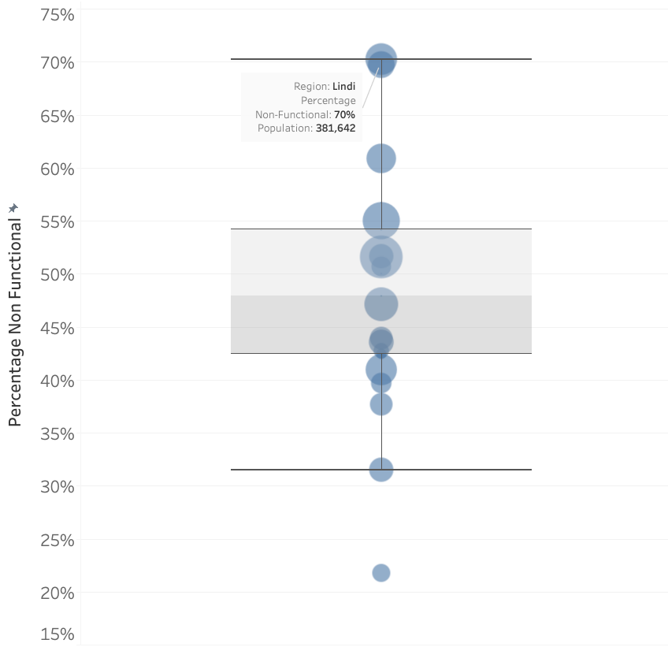
Percentage of Non-Functional Wells by Region
Distribution Percentage Non-Functional by Region
Sized by population

Slide 19
31 FH
Amount of Static Head by Well Status
23 FH
Functional
Non Functional
Amount of Static Head by Water Quantity
Enough
30 FH
Insufficient
28 FH
Dry
22 FH
Seasonal
18 FH
Unknown
16 FH

Slide 20
Percent Non-Functional by Well Age

Slide 21
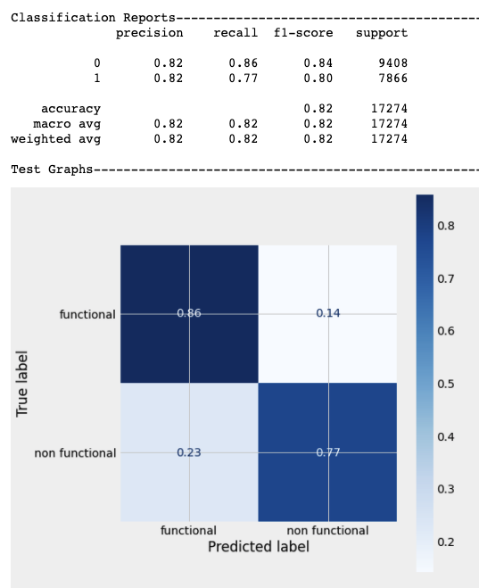
Random Forest Model Results

